Slide 1
RENEWABLE ENERGY • PREDICTIVE MAINTENANCE
Predictive Maintenance of Solar Trackers
via Motor Current Signature Analysis (MCSA)
Current Acquisition → Signal Processing → Feature Extraction → Fault Detection → Maintenance Alert

Slide 2
CONTENTS
01. Introduction
05. Findings
02. Background
06. Discussion
03. Objectives
07. Reflection
04. Methodology
08. Conclusion

Slide 3

01
Introduction
Solar PV plants increasingly rely on single/dual-axis trackers to boost energy yield.
Tracker motors and gear mechanisms are naturally prone to wear-related faults.
Undetected motor faults reduce tracking accuracy, power output, and increase maintenance cost.
This project applies Motor Current Signature Analysis (MCSA) — a non-invasive technique — to detect tracker motor faults early.
PROJECT SNAPSHOT
DOMAIN
Renewable Energy & Predictive Maintenance
TECHNIQUE
Motor Current Signature Analysis (MCSA)
TARGET
Single/Dual-Axis Solar Tracker Motors
PROCESSING
FFT, DWT, Statistical Feature Extraction
MCSA-Based Predictive Maintenance for Solar Trackers
Introduction

Slide 4

02
Background & Motivation
The growing deployment of solar PV plants has made trackers essential for maximizing energy generation — but motor and gear failures threaten that gain.
Solar trackers operate continuously under varying environmental conditions.
Mechanical wear gradually affects motor performance over time.
1
2
Unexpected motor failures reduce plant availability and revenue.
MCSA enables non-invasive fault monitoring using existing current signals.
3
4
Early fault detection reduces downtime and maintenance costs.
Predictive maintenance improves overall system reliability and energy yield.
5
6
MCSA-Based Predictive Maintenance for Solar Trackers
Background

Slide 5

03
Objectives
To develop a predictive maintenance system for solar tracker motors using Motor Current Signature Analysis (MCSA) for early fault detection and maintenance scheduling.
Design a laboratory-scale solar tracker monitoring system.
Acquire motor current using a Hall-effect current sensor.
Perform Motor Current Signature Analysis on the acquired data.
Extract diagnostic features from current signals (FFT / DWT / statistical).
Detect abnormal motor operating conditions.
Generate maintenance alerts before failure occurs.
Improve tracker reliability while minimizing maintenance cost.
MCSA-Based Predictive Maintenance for Solar Trackers
Objectives

Slide 6
Research Questions & Gap
RESEARCH QUESTIONS
RESEARCH GAP
Can motor current signatures accurately identify faults in solar tracker motors?
Which signal processing technique (FFT, DWT, Statistical Features) gives better fault detection performance?
Can early-stage mechanical faults be detected before complete motor failure occurs?
How effectively can predictive maintenance improve tracker system reliability?
Most existing studies focus on PV panel-level faults; tracker motor health monitoring gets limited attention.
Existing predictive maintenance mostly uses vibration/temperature sensors — higher cost, more complex installation.
MCSA application to solar tracker motor fault diagnosis is still limited in literature.
Few studies offer a real-time, low-cost predictive maintenance framework specifically for tracker mechanisms.
MCSA-Based Predictive Maintenance for Solar Trackers
Research Questions & Gap

Slide 7

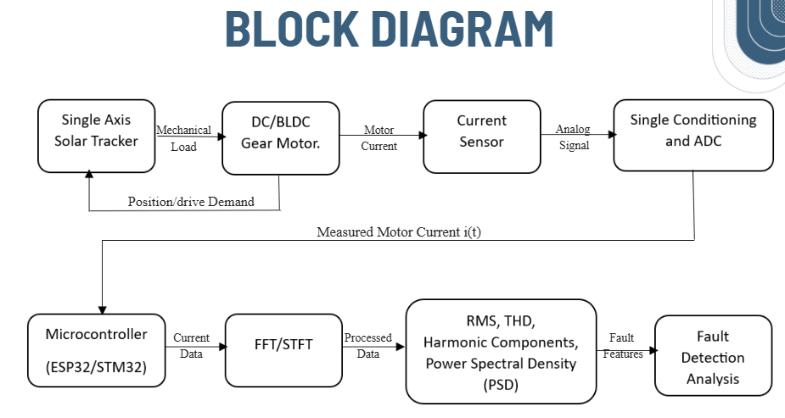
04
Methodology — System Block Diagram
MCSA-Based Predictive Maintenance for Solar Trackers
Methodology

Slide 8
04
Methodology — Process Stages
1
The solar tracker motor operates under normal tracking conditions.
2
Motor current is continuously measured using an ACS712 current sensor.
3
The analog signal is conditioned and digitized using an ADC (ADS1115).
4
Current data is acquired through an ESP32 / STM32 microcontroller.
5
Motor Current Signature Analysis is performed using FFT / DWT.
6
Fault-related features — harmonic components, RMS, frequency peaks — are extracted.
7
A fault classification algorithm determines the motor's health condition.
8
Maintenance alerts are generated whenever abnormal conditions are detected.
MCSA-Based Predictive Maintenance for Solar Trackers
Methodology

Slide 9
Hardware & Software Requirements
Component / Software | Purpose
MATLAB / Simulink | Signal processing & simulation
Arduino IDE | Microcontroller programming
ESP32 / STM32 | Data acquisition
ACS712 Current Sensor | Motor current measurement
ADS1115 ADC | Signal digitization
DC / BLDC Motor | Solar tracker actuator
Motor Driver | Motor control
Power Supply | System operation
WHY THESE COMPONENTS?
Low-cost: total hardware under ₹10,000
Non-invasive: current sensor only, no vibration/temperature hardware
Edge-capable: ESP32/STM32 process signals in real time
MCSA-Based Predictive Maintenance for Solar Trackers
Hardware & Software

Slide 10


Cost Estimation & Timeline
COST ESTIMATION
PROJECT TIMELINE (6 MONTHS)
Component | Approx. Cost (₹)
ESP32 Development Board | 700
ACS712 Current Sensor | 250
ADS1115 ADC | 300
Motor Driver | 500
DC / BLDC Motor | 2,000
Mechanical Tracker Prototype | 3,500
Power Supply | 800
Miscellaneous Components | 1,000
Total Estimated Cost | ≈ 9,050
Month 1
Literature Survey & Research Paper Review
Month 2
Problem Definition & System Design
Month 3
MATLAB / Simulink Model Development
Month 4
MCSA Implementation & Feature Extraction
Month 5
Simulation Testing & Performance Analysis
Month 6
Documentation & Software Validation
MCSA-Based Predictive Maintenance for Solar Trackers
Cost & Timeline

Slide 11

Literature Survey
11 papers reviewed — base papers, MCSA/ML techniques, and solar PV predictive maintenance

Slide 12
Literature Survey
Part 1 of 3 — Papers 1–4
# | Title & Year | Key Contribution | Demerit
1 | Machine Learning for PV Single Axis Tracker Fault Detection and Classification (Base Paper 1) (2025) | Real-time ML framework (XGBoost Predictor + Classifier) detects and classifies SAT Stall & Timing Mismatch faults with near-zero false positives. | Detects only software/tracking faults, not motor-level mechanical wear.
2 | An Autoregressive-Based MCSA Approach for Fault Diagnosis of Electric Motor-Driven Mechanisms (Base Paper 2) (2025) | Combines wavelet transform with autoregressive spectral estimation; defines a SISSD health indicator for motor-driven mechanism fault diagnosis. | Fault severity isolation was unreliable in several test configurations.
3 | Condition Monitoring of Bearing Damage — A Benchmark Data Set for Data-Driven Classification (2016) | Released a widely-used, labeled benchmark dataset of motor current signals for bearing-fault classification research. | Data from constant-speed industrial motors, not intermittent tracker operation.
4 | Motor Current Signature Analysis for Fault Detection of Induction Machine — A Review (2021) | Consolidates time- and frequency-domain MCSA techniques for induction machine fault interpretation. | Purely a review with no experimental validation.
MCSA-Based Predictive Maintenance for Solar Trackers
Literature Survey

Slide 13
Literature Survey
Part 2 of 3 — Papers 5–8
# | Title & Year | Key Contribution | Demerit
5 | A Deep Autoencoder-Based CNN Framework for Bearing Fault Classification in Induction Motors (2021) | Semi-supervised DAE + 1-D CNN pipeline achieves bearing-fault classification accuracy exceeding 99%. | Computationally heavy, not optimized for low-power edge devices.
6 | Improved CNN-Based Bearing Fault Diagnosis Using Multi-Phase Motor Current Signals (2025) | Multi-phase CNN (MI-CNN) achieves ~95.12% accuracy on noisy current signals at 20 dB SNR. | Requires multi-phase current access, unavailable on many tracker motors.
7 | Robust MCSA-Based Fault Detection Under Varying Operating Conditions (2022) | Beamforming-based spectral estimation robustly detects faults under varying load and noisy conditions. | Validated on only a single fault type (minor eccentricity).
8 | Induction Motor Bearing Fault Classification Using DNN with PSO-XGBoost (2024) | Hybrid statistical + deep-learning features with PSO-optimized XGBoost improve classification accuracy. | Complex hybrid pipeline relying on vibration-based benchmark comparisons.
MCSA-Based Predictive Maintenance for Solar Trackers
Literature Survey

Slide 14
Literature Survey
Part 3 of 3 — Papers 9–11
# | Title & Year | Key Contribution | Demerit
9 | A Motor Current Signal Based Bearing Fault Diagnosis Using Deep Learning and Information Fusion (2019) | Fuses motor current with drive DC current using deep learning for improved fault detection confidence. | Requires extra drive-level DC current sensing, increasing cost.
10 | Faults, Failures, Reliability, and Predictive Maintenance of Grid-Connected Solar Systems: A Review (2025) | Reviews PV fault taxonomy and shows AI/ML/IoT approaches enhance predictive diagnostics over reactive methods. | General PV review; no focus on tracker motors specifically.
11 | AI-Based Predictive Maintenance of Solar Photovoltaic Systems: A Comprehensive Review (2025) | Structured review of 40 papers on ML/DL-based PV predictive maintenance, evaluated via standard metrics. | Focused on panel/inverter-level maintenance, not tracker motor health.
MCSA-Based Predictive Maintenance for Solar Trackers
Literature Survey

Slide 15

05
Findings (Expected Outcomes)
Detect motor faults during the early stages.
Improve the reliability of solar tracking systems.
✓
✓
Reduce unexpected tracker failures.
Minimize maintenance cost through condition-based maintenance.
✓
✓
Increase operational efficiency of photovoltaic plants.
Improve energy generation by maintaining accurate panel tracking.
✓
✓
Demonstrate a practical, low-cost predictive maintenance solution.
✓
MCSA-Based Predictive Maintenance for Solar Trackers
Findings

Slide 16

06
Discussion
SIGNAL PROCESSING TECHNIQUE COMPARISON
Technique | Strength | Trade-off
FFT | Fast, simple frequency-domain view of steady current | Poor with non-stationary / transient signals
DWT | Captures both time and frequency information | Higher computation, filter/level selection needed
Statistical Features | Lightweight (RMS, peaks); easy to compute on edge devices | Less sensitive to subtle, early-stage faults
WHY MCSA OVER VIBRATION / TEMPERATURE SENSING?
Uses the motor's own current — no extra vibration or temperature hardware needed
Lower cost and simpler installation than multi-sensor condition monitoring rigs
Fits the project's low-cost, real-time, edge-deployable design goals
MCSA-Based Predictive Maintenance for Solar Trackers
Discussion

Slide 17

07
Reflection
WHAT WORKED WELL
CHALLENGES FACED
WHAT WE'D IMPROVE
Low-cost setup using a single current sensor
No extra vibration/temperature hardware required
Real-time, edge-deployable microcontroller pipeline
Collecting clean, representative fault data
Filtering noise from real-world current signals
Emulating realistic fault conditions safely
Test more fault types and severities
Longer real-world / field testing duration
Compare more signal processing techniques
MCSA-Based Predictive Maintenance for Solar Trackers
Reflection

Slide 18
08
Conclusion
A low-cost, non-invasive MCSA-based predictive maintenance system is proposed for solar tracker motors.
The system captures motor current, processes it (FFT/DWT), and extracts features to detect faults early.
Expected to reduce downtime, cut maintenance costs, and improve solar plant reliability and energy yield.
Future work: field deployment on live trackers and integration with SCADA/IoT monitoring dashboards.
Thank You

